Slide 1

ASHIKUR RAHMAN AGRO
Md. Ashikur Rahman
Batch:20
Roll:01-020-01
Date:06.10.2024

Slide 2
Introduction
Ashikur Rahman Agro Farm is a prominent agricultural enterprise located in Khulna Bangladesh. Specializing in the cultivation of essential crops such as rice, potatoes, wheat, vegetables, and fruits, the farm plays a crucial role in meeting the local demand for these staples. By ensuring a steady supply of high-quality produce, Ashikur Rahman Agro Farm not only supports the dietary needs of the local population but also contributes significantly to the economic stability and growth of the region.
The farm’s operations are designed to maximize productivity while adhering to sustainable farming practices. This approach not only enhances the farm’s output but also ensures the longterm health of the soil and surrounding environment.
Through its commitment to quality and sustainability, Ashikur Rahman Agro Farm has established itself as a key player in the local agricultural sector, fostering food security and economic resilience in Khulna and beyond

Slide 3
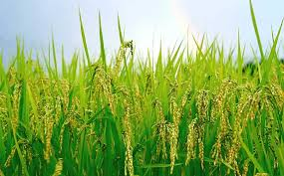
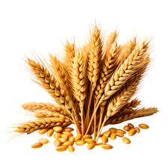
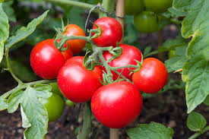
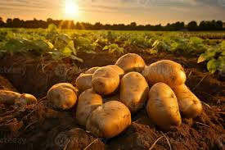
Majore Products of Agro
Rice
wheat
Tomato
Potato

Slide 4
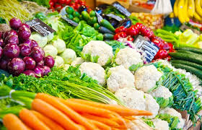
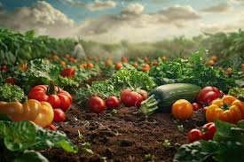
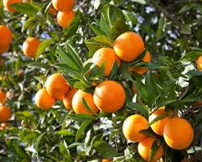

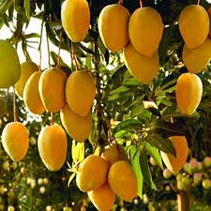
Vegetables
Seasonal Production
Fruits
Orange
Banana
Mango

Slide 5
Service to customer
High-Quality Produce
Customer-Centric Approach
Educational Outreach
Sustainability and Environmental Responsibility
Customer Support :Responsive Service: The farm’s customer service team is always ready to assist with inquiries, orders, and any issues that may arise. Feedback and Improvement: Customer feedback is highly valued and used to continuously improve the quality of products and services. Ashikur Agro Farm is committed to delivering the best possible experience to its customers, ensuring they receive fresh, high-quality produce while supporting sustainable and environmentally friendly practices

Slide 6
We can create a pie chart to show the distribution of different crops produced by Ashikur Rahman Agro Farm:
Crop Product | Total Land
Rice | 20%
Wheat | 10%
Potatoes | 25%
Tomatoes | 15%
Vegetable | 25%
Fruits | 15%

Slide 7
My Agro Farm’s business plan
Production Plan
Wheat Production
Fruit Production
Potato Production
Rice Production
Financial Projections
Revenue Streams
Cost Management
Creation Job
Economic Impact
Market Stability

Slide 8
Crops Production Tabel & Chart
Crop product | 2020-21(MT) | 2022-23(MT) | 2023-24(MT)
RICE | 2300 | 3300 | 2300
WHEAT | 3400 | 4500 | 6500
POTATOS | 4500 | 2300 | 4590
TOMATOS | 4300 | 4500 | 4560
FRUITS | 4500 | 2100 | 4360

Slide 9
Conclusion Ashikur Rahman Agro Farm significantly contributes to the local economy and food security in Khulna, Bangladesh, by producing a variety of essential crops. Here's a detailed look at its contributions As staple foods in Bangladesh, the production of rice and wheat by Ashikur Rahman Agro Farm helps to meet the daily dietary needs of the local population. This reduces dependency on imports and stabilizes local food prices. These are crucial for a balanced diet, providing essential nutrients. The farm's production ensures a steady supply of fresh produce, enhancing the nutritional intake of the community. By growing a variety of fruits, the farm adds diversity to the local diet and supports overall health and well-being.The farm provides employment opportunities for local residents, contributing to the reduction of unemployment and boosting the local economy. By supplying local markets with a consistent flow of agricultural products, the farm helps stabilize prices and ensures that local businesses have reliable access to fresh.

Slide 10
Similar Agro Farm
Farming Future Bangladesh (FFB)
Amir Agro Farm
Organic Farming
Farmshelf
Babylon Micro-Farms Inc
Clean Crop Technologies
Tortuga AgTech

Slide 11





Contact Information
ashikurrahmanagro09@gmai.com
Ashikur Rahman Agro
+8801772500329
Khulna, Bangladesh

Slide 12


